Slide 1
Introduction to Visual Recognition
Theory and Practice in a Coding and Non-Coding Environment

Slide 2
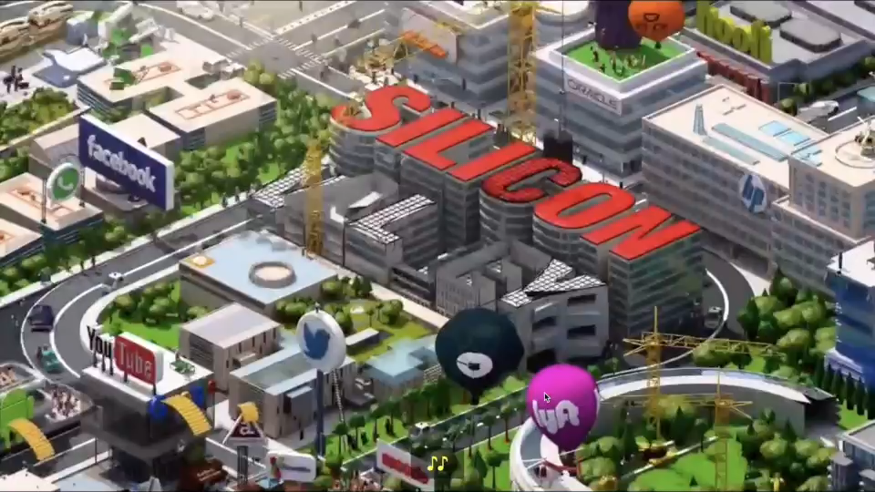
What are we doing here again?

Slide 3
Agenda
1
Deep Learning Theory
2
Why Deep Learning
3
Deep Belief Networks
4
Hands-On Labs

Slide 4


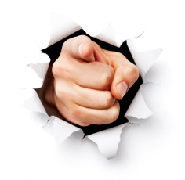
Introductions
Erica Reuter
Technical Evangelist
Erika Bratschun
Technical Evangelist
YOU
Title
Interest in Topic

Slide 5
Objectives
Understand the Theory of Deep Learning
Differentiate Deep Learning from Machine Learning, and know when best to use each
Successfully build Image classifiers in both a coding and non-coding environment
Upon completion of this module, you should be able to:

Slide 6
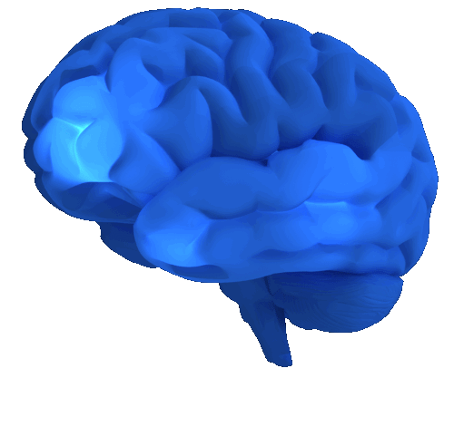
Deep Learning Introduction
Deep Learning is inspired by the human brain, it attempts to mimic the activity in layers of neurons in the human brain where thinking occurs.

Slide 7
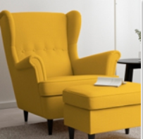
Deep Learning Introduction
Deep Learning in Action
https://www.clarifai.com/demo

Slide 8
Deep Learning is…
a collection of statistical machine learning techniques
used to learn feature hierarchies
based on artificial neural networks

Slide 9
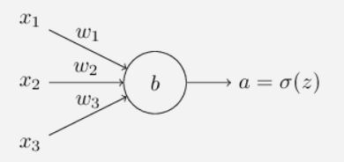
Deep Learning Introduction
Activation of a neuron
w_{i} - weights, w1,w2,…, real numbers expressing the importance of the respective inputs to the output
b – bias, a measure of how easy it is to get the neuron to fire
The output from the neuron is a real number between 0 and 1
The neural net “learns” by tweaking the weights and biases step by step until the prediction closely matches the correct output, i.e. minimize the “cost value”
The rate at which the cost value changes with respect to a weight or bias is known as “gradient”

Slide 10
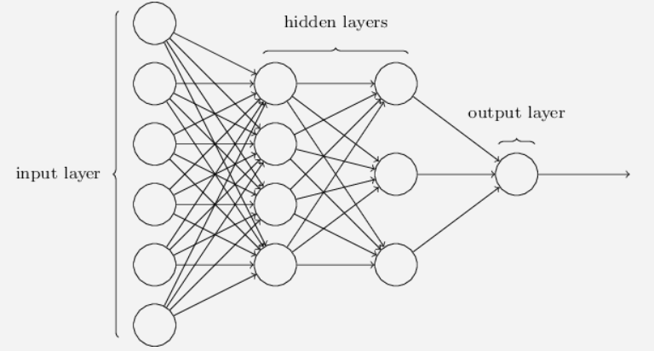
Deep Learning Introduction
Each node in the hidden and output layer has its own classifier
Firing of a classifier, or activation, produces a score
Forward Propagation
Scores are passed on as input to the next layer
Input layer: Ingest input values, e.g. pixels of an image, vital statistics of a patient
Output layer: The predicted value. e.g. the category of the image or if the patient is sick

Slide 11
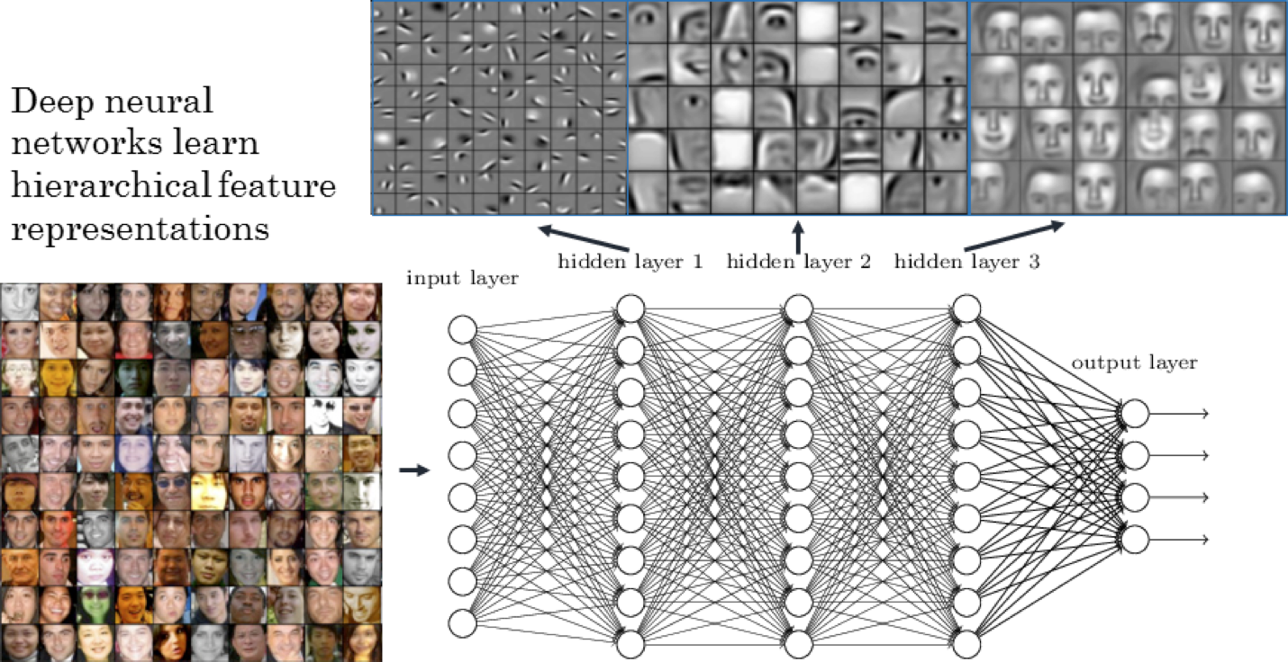
Deep Learning Introduction
Deep Learning algorithms learn “Feature Hierarchies” as they progresses through their hidden layers

Slide 12
Why the need for Deep Learning?

Slide 13
Why Deep Learning? Why now?
DL algorithms learn more complex patterns than is possible with traditional machine learning algorithms
Simple
Moderate
Complex
Pattern Complexity
Basic Classifiers:
Logistic Regression or SVM
Traditional Shallow Neural Network
Deep Net
Increased availability of labelled data
Deep nets take a long time to train
Availability of high performance GPUs speeds up training of a deep net
GPU is approximately 250 times faster than CPU, i.e. the difference between one day of training and over eight months.
Notes:
If you only need to analyze simple patterns, a basic classification tool like an SVM or Logistic Regression is typically good enough.
But when your data has 10s of different inputs or more, neural nets start to win out over the other methods.
As the patterns get even more complex, shallow neural networks can become unusable. The reason is that the number of nodes required in each layer grows exponentially with the number of possible patterns in the data.
Eventually training becomes way too expensive and the accuracy starts to suffer. So for an intricate pattern – like an image of a human face, for example – basic classification engines and shallow neural nets simply aren’t good enough – the only practical choice is a deep net.
Why now?
One of the fascinating things about neural networks is how long they have taken to be an over night success. The history goes back all the way to the 1950s. Deep learning has really only taken off in the last five years. The reason is the increased availability of label data along with the greatly increased computational throughput of modern processors.
For a long time, we didn't have the huge labelled data sets that we needed to make deep learning work. Those data sets only became widely available with the rise of the Internet, which made collecting and labeling huge datasets feasible. But even when we had big datasets, we often didn't have enough computational power to make use of them and it is only been in the last five years that processors have gotten big enough and fast enough to train large scale neural networks.
Shallow neural network – just 1 hidden layer
Deep nets – able to build up a complex hierarchy of concepts

Slide 14

Make me a lego shark!

Slide 15
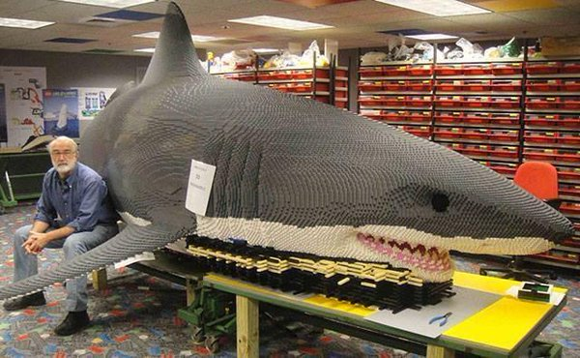
Make me a Lego shark with deep learning

Slide 16
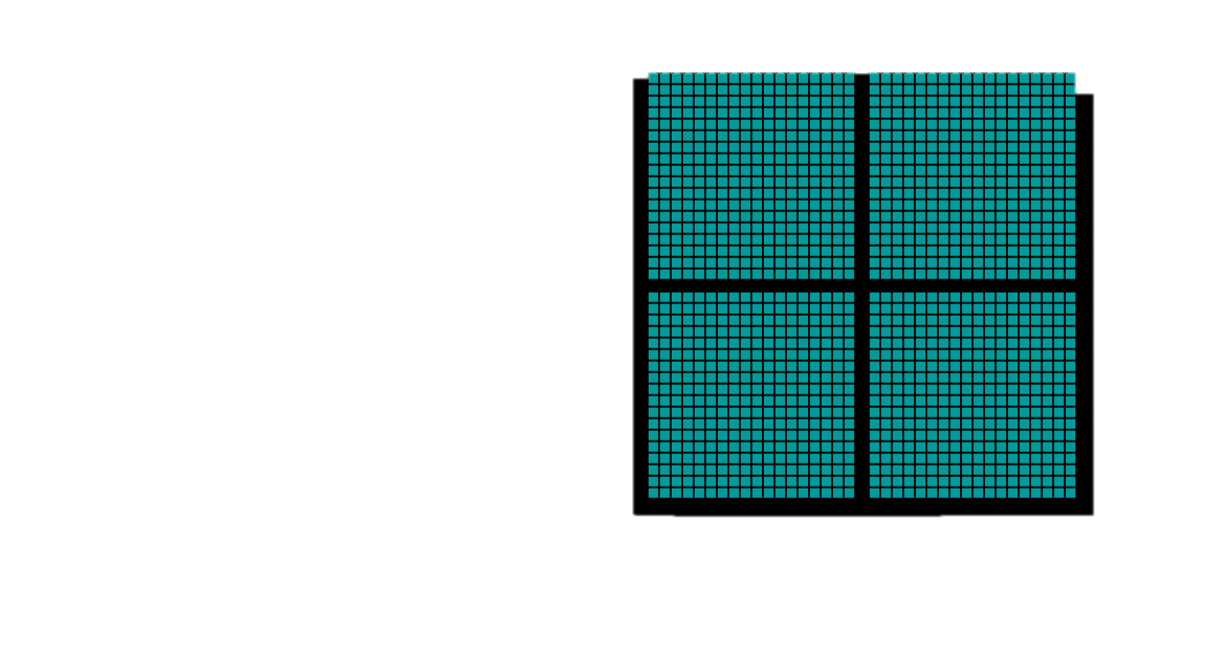
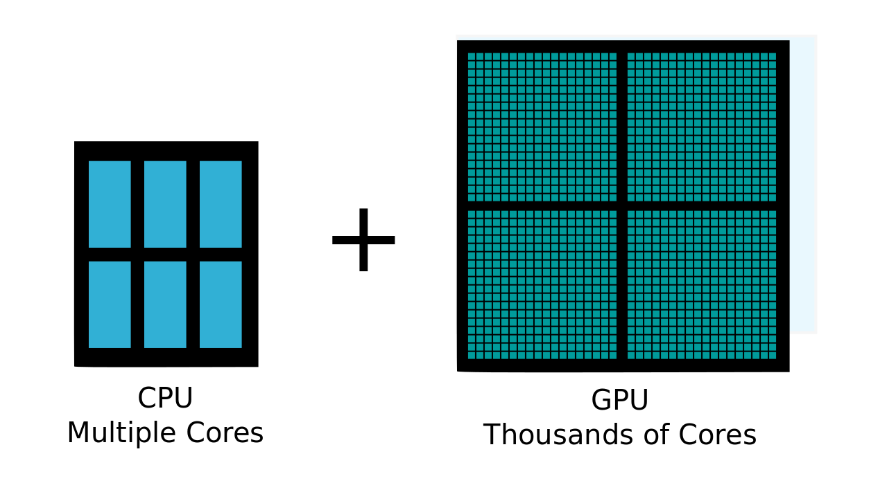
CPUs have multiple cores, whereas GPUs have thousands of cores
https://www.youtube.com/watch?v=-P28LKWTzrI
CPU
Multiple Cores
GPU
Thousands of Cores
Notes:
Originally, GPUs were purpose-built for computational problems in the computer graphics industry

Slide 17
Key Differences between traditional “Machine Learning” and “Deep Learning”
 | Machine Learning | Deep Learning
Data Volumes | Can work on small data volumes | Needs large data volumes
Feature Engineering | Needs a lot of data preparation and feature engineering | Feature engineering is implicitly performed during training
Hardware | CPU and/or GPU | Needs accelerators such as GPUs
Model Interpretability | Models are easy to interpret (e.g., Decision Trees) | Difficult to understand why the model produces a given prediction
Notes:
https://www.analyticsvidhya.com/blog/2017/04/comparison-between-deep-learning-machine-learning/
The most important difference between deep learning and traditional machine learning is its performance as the scale of data increases. When the data is small, deep learning algorithms don’t perform that well. This is because deep learning algorithms need a large amount of data to understand it perfectly.
Feature engineering is a process of putting domain knowledge into the creation of feature extractors to reduce the complexity of the data and make patterns more visible to learning algorithms to work. E.g. we extract, day, month, year, duration from a date field to make patterns more “visible”, we reclassify or bin values, or we drop highly correlated fields. Deep learning algorithms try to learn high-level features from data. Like, Convolutional NN will try to learn low-level features such as edges and lines in early layers then parts of faces of people and then high-level representation of a face.
Deep learning algorithms heavily depend on high-end machines with GPUs, contrary to traditional machine learning algorithms, which can work on low-end machines. Deep learning algorithms inherently do a large amount of matrix multiplication operations, which GPUs are designed to do.
Machine learning algorithms like decision trees give us crisp rules as to why it chose what it chose, so it is particularly easy to interpret the reasoning behind it. Therefore, algorithms like decision trees and linear/logistic regression are primarily used in industry for interpretability.

Slide 18
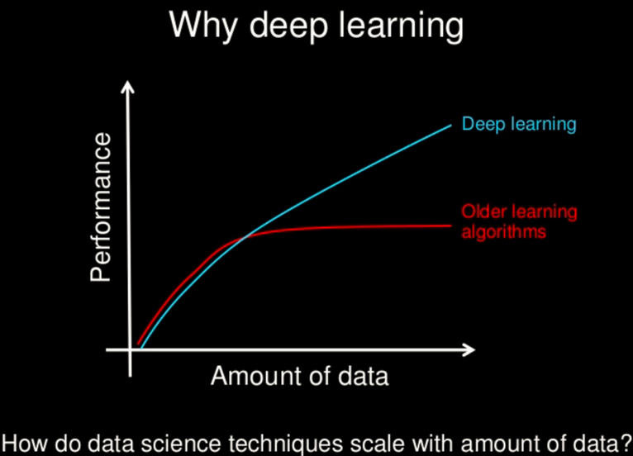
Notes:
for most flavors of the traditional learning algorithms … performance will plateau. … deep learning … is the first class of algorithms … that is scalable. … performance just keeps getting better as you feed them more data
https://www.slideshare.net/ExtractConf/andrew-ng-chief-scientist-at-baidu

Slide 19
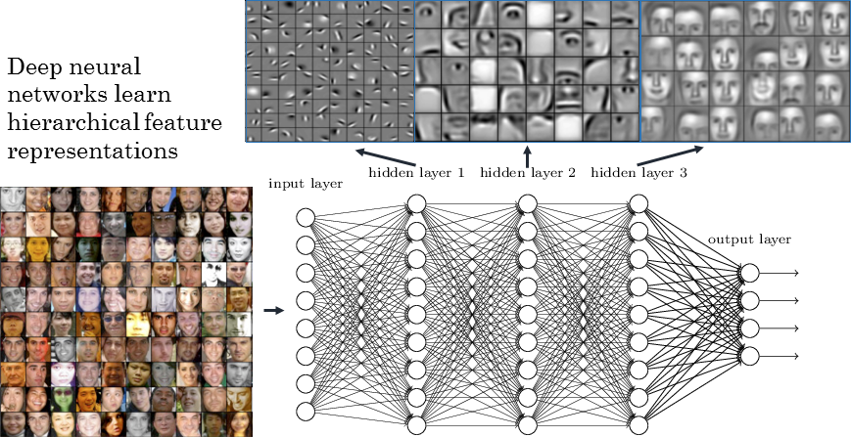
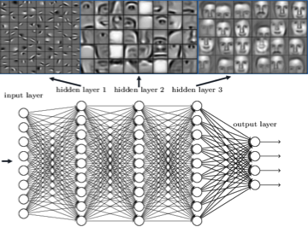
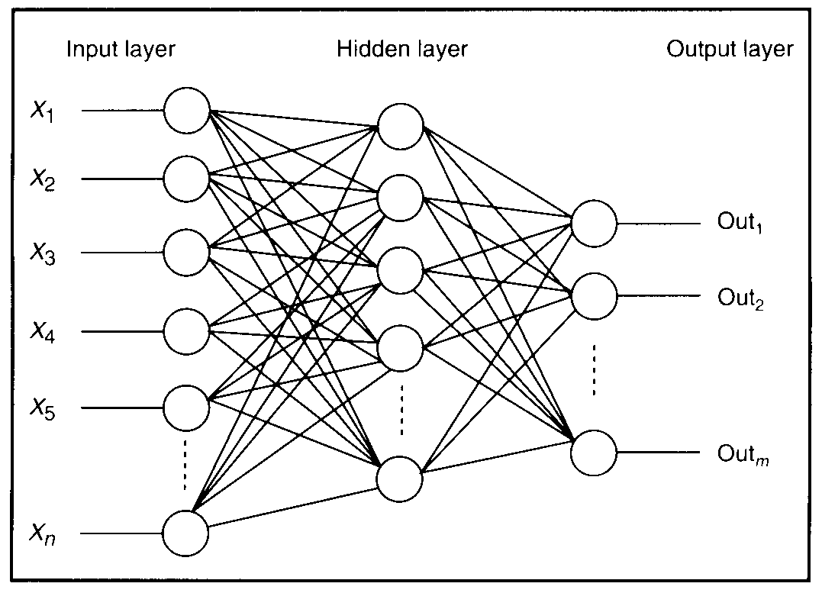
Deep Learning is…
a collection of statistical machine learning techniques
Deep Boltzmann Machine (DBM)
Deep Belief Networks (DBN)
Convolutional Neural Networks (CNN), etc.
used to learn feature hierarchies
based on artificial neural networks
Notes:
https://www.datarobot.com/blog/a-primer-on-deep-learning/
19
KEY IDEAS OF DEEP LEARNING
Hierarchical non-linear system
Distributed representations
Sharing
End-to-end learning
Joint optimization of features and classifier
Good features are learned as a side product of the
learning process
Deep learning is a particular kind of machine learning that achieves great power and flexibility by learning to represent the world as nested hierarchy of concepts, with each concept defined in relation to simpler concepts, and more abstract representations computed in terms of less abstract ones
There is no single definition of deep learning, but most definitions emphasize:
Branch of machine learning
Models are graph structures (networks) with multiple layers (deep)
Models are typically non-linear
Both supervised and unsupervised methods are used for fitting models to data

Slide 20
Application of Deep Learning

Slide 21
The boundary of what are Deep Learning “Use Cases” I s still evolving... due to new techniques and expectations
Sunspring
Cell Photo Search
“Deep Learning” Use Cases
Music retrieval
Customer Churn
Image, Audio, Text
Market Basket Analysis
“Shallow Learning” Use Cases
So far, people have mostly been sticking to problems and datasets that naturally have a hierarchical structure – although, like with any hot technology, people will be experimenting with DL on all types of problems
Notes:
Successful application domains (e.g., Watson APIs)
Image: object recognition, optical character recognition
Audio: speech recognition, music retrieval, transcription
Text: parsing, sentiment analysis, machine translation
Notes from Alex: Slide 20/21 - no use cases? even non-IBM applications of deep learning where there is some tangible business value? Consider including a section later in the lab or at the end where use cases/applications are discussed with the attendees after they have a better grasp of DL. Slide 21 is a good opportunity for that discussion but not sure the audience would be prepared to brainstorm additional applications of DL

Slide 22
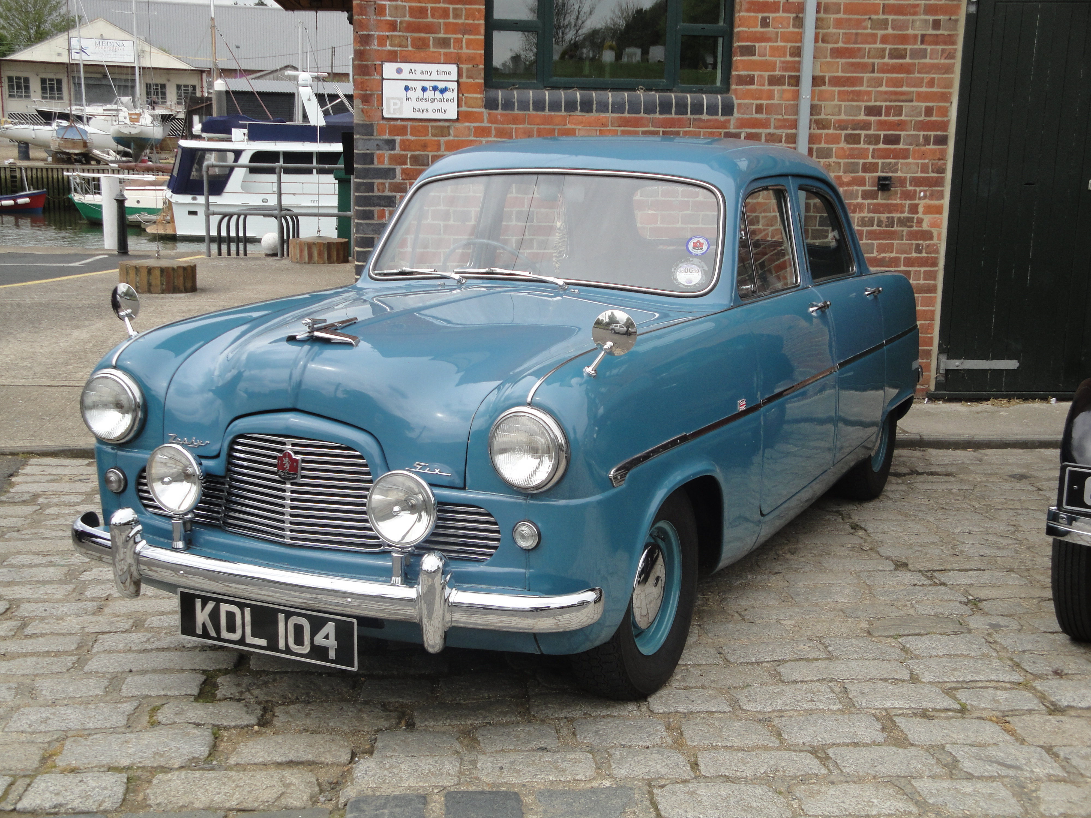
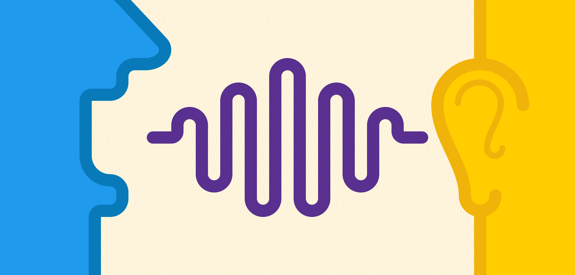
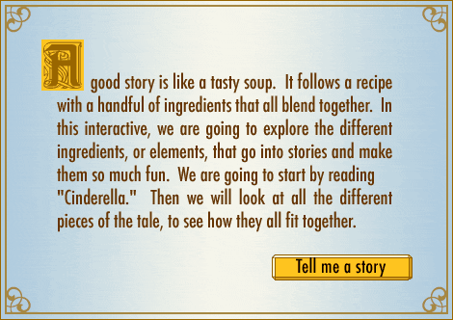
Deep Learning is structured to be effective in problem domains which have an inherently Hierarchical Composition
VISION
pixels -> edge -> texton -> motif -> part -> object
e.g. self-driving cars, reading medical images
SPEECH
sample -> spectral band -> formant -> motif -> phone -> word
e.g. Alexa
NATURAL LANGUAGE PROCESSING
character -> word -> clause -> sentence -> story
e.g. DeepText: Facebook's text understanding engine
Notes:
https://code.facebook.com/posts/181565595577955/introducing-deeptext-facebook-s-text-understanding-engine/
Hierarchy important for classification/categorization - Hot Dog / Not Hot Dog
- often hiercherial classification
Textons refer to fundamental micro-structures in generic natural images and the basic elements in early (pre-attentive) visual perception.
A formant is a concentration of acoustic energy around a particular frequency in the speech wave

Slide 23
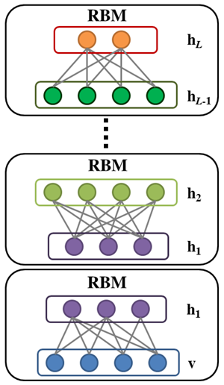
Modeling
A DBN consist of multiple layers of unsupervised
Restricted Boltzmann Machines (RBMs) where the output of each RBM
is used as input to the next.
Textons
(the basic elements in early
(pre-attentive) visual perception
Edges
Pixels

Slide 24
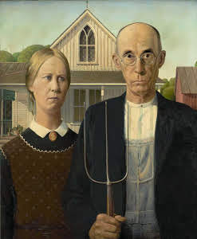

Slide 25
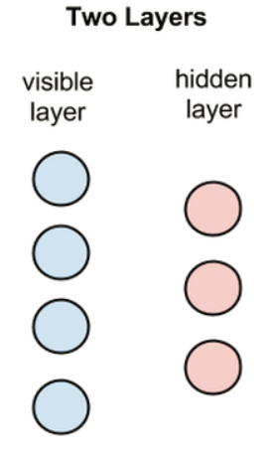
Modeling: Restricted Boltzmann Machines (RBMs)
RBMs are shallow, two-layer neural nets that constitute the building blocks of deep-belief networks(DBN).
Key features of RBMs:
In the forward pass, an RBM takes the inputs and translates them into a set of numbers that encode the inputs
In the backward pass, it takes this set of numbers and translates them back to form the re-constructed inputs. The reconstruction is compared against the original input to determine the quality of the result.
These forward/backward passes are repeated over and over through the training process
In both steps, the weights and biases allow the RBM to decipher the interrelationships among the input features, and help the RBM decide which input features are the most important when detecting patterns.
Notes:
An RBM is considered “restricted” because no two nodes in the same layer share a connection.

Slide 26
Deep Belief Network (DBN)
A deep belief network can be viewed as a stack of RBMs, where the hidden layer of one RBM is the visible layer of the one "above" it
After this initial training, the RBMs have created a model that can detect inherent patterns in the data. But we still don’t know exactly what the patterns are called.
To finish training, we introduce labels to the patterns and fine-tune the net with supervised learning.
A stack of RBMs will outperform a single unit
Notes:
A DBN is trained as follows:
a) The first RBM is trained to re-construct its input as accurately as possible
b) The hidden layer of the first RBM is treated as the visible layer for the second and the
second RBM is trained using the outputs from the first RBM
c) This process is repeated until every layer in the network is trained
Each RBM layer learns the entire input, so the learning process is like focusing the lens of a camera to get a clearer and clearer picture

Slide 27
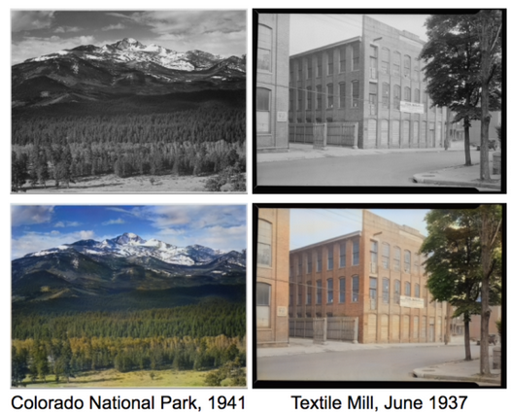
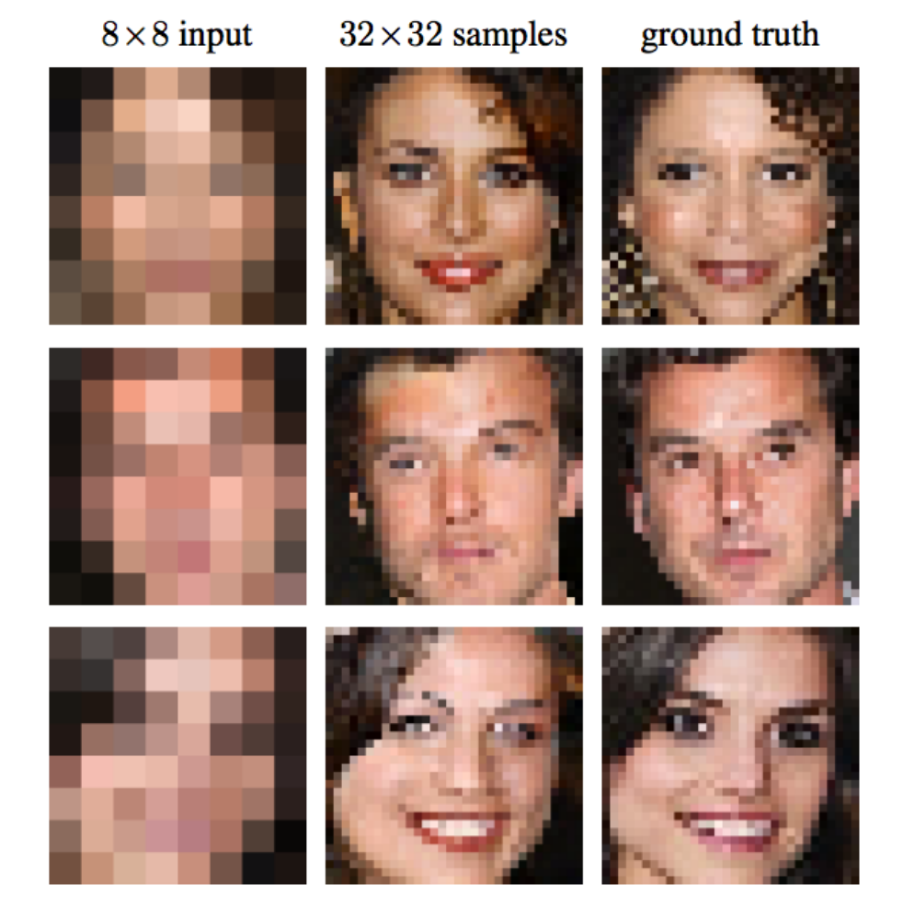
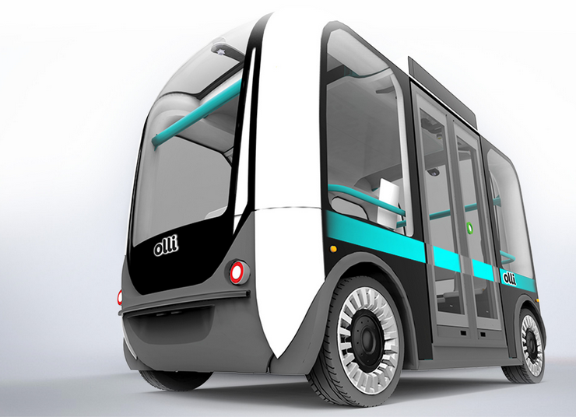
Use Cases
Restore Colors to B/W Photos
Pixel Restoration: CSI Style
Self Driving Cars
Notes:
Color Restoration → black and white photos (old fashion) to turn into color; The Deep Learning network actually learned patterns that naturally occur in photos - the sky is usually blue, clouds are often white/gray and grass is typically green in order to restore these colors. But it did so itself from its past experience without human intervention.
Pixels: Well, it was unrealistic until Deep Learning. Early in 2017, Google Brain researchers trained a Deep Learning network to take very low resolution images of faces and predict what each face most likely looks like. They call the method Pixel Recursive Super Resolution which enhances resolution of photos significantly. In the image below you can see the original 8x8 photos, the ground truth (which was the real face originally in the photos) and in the middle the guess of the computer. Obviously it is not perfect, as it cannot be, but it is pretty unbelievable that the computer can guesstimate so well many of the features of the person in the photo.
http://www.yaronhadad.com/deep-learning-most-amazing-applications/
Other: Netflix: Visual recognition: pick up on cues such as introductions; the “Skip intro button” based on repeated pattern in episodes
https://www.marketwatch.com/story/netflix-uses-frame-by-frame-machine-learning-to-decide-what-you-really-want-to-watch-2017-09-27
Self driving cars

Slide 28
Hands On Lab

